Slide 1


Earth Surface Change
Presented By: Kayla Brown

Slide 2
Outline
History
Why are disposal cell important?
Monitoring Performance Overtime
Project: Documenting Surface Change on UMTRCA Covers
Process
Summary of sites
Key findings and takeaway

Slide 3
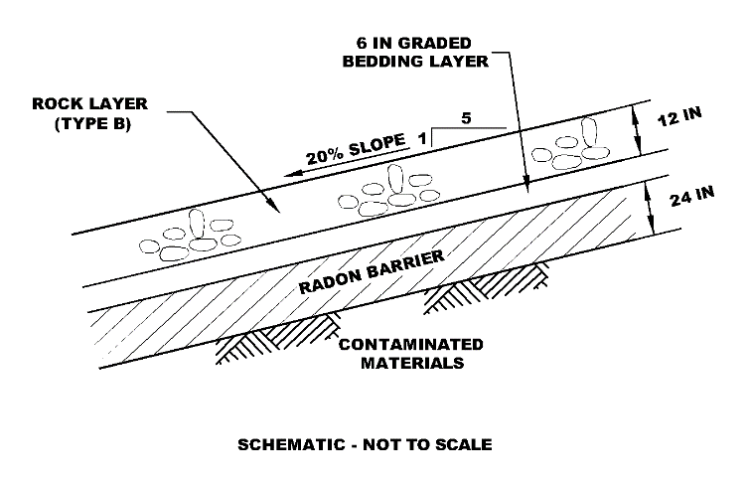

History
Uranium mills were created to extract uranium for military, and energy production. However, because of this it has caused a hazard to the environment and human health.
If left uncovered, these uranium mill tailings can contaminate air, water, and soil.
To cleanup and stabilize uranium mill tailings, congress enacted the Uranium Mill Tailings Radiation Control Act (UMTRCA) in November 1978.
Notes:
Rock riprap surficial layer
30-cm thick
Provides long-term erosion protection
Bedding layer
15-cm thick
Sandy gravel with fines
Intended as a graded filter material for
reducing interstitial flow velocities and
preventing internal migration of fines
Radon barrier layer
60-centimeters (cm) thick
Compacted bentonite-amended admixture
Locally sourced soils used

Slide 4
Why are disposal cells important?
Disposal cells in the Uranium Mill Tailings Radiation Control Act (UMTRCA) are designed to isolate wastes through limiting radon diffusion, reducing water percolation, and controlling erosion.
There are many engineered cover designs to choose from depending on the site’s environment.
These disposal cells can change overtime because the environment there in and the way they were built. These changes can produce ponding, increase in vegetation, erosion, rock breakdown, etc on the surfaces of the cell. Sometimes these changes can affect performance.

Slide 5
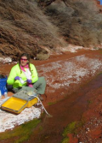
Monitoring Performance Overtime
In order to survey and maintain these disposal sites, we conduct annual inspections.
Annual inspections are performed to keep track of changes over time, at least once a year, to identify year-over-year natural and man-made changes to cover performance.
To compare the changes throughout the years on the site, pictures and maps are conducted.
Notes:
Add picture with people with clipboards

Slide 6

Project: Documenting Surface Change on UMTRCA Covers
My project looked at multiple different sites to document how they have changed overtime.
I reviewed all of the annual inspection reports for five sites that were built in different ways in different environment and documented how they changed since construction.

Slide 7
Process
Timeline of Events
Annual Inspection reports
Fill in excel spreadsheet
Extract photos and maps
Notes:
Annual Inspection Reports
Start with the oldest report all the way to the present
Read through report and look for keywords such as erosion, ponding, earthquake, weeds, rock breakdown, etc.
Look at annotated maps and photographs
Input into excel spreadsheet: more, less, same
Excel Spreadsheet
On the far-left column is categories labeled biological, geophysical, management and others which indicates the changes that have occurred on the sites
There are numbers in the top row which indicates the number of years since construction of the site
There are columns labeled more, less, or same for each year to determine if the change has increased or decreased or remained same
For example, if there were more erosion occurring in year 3 than in year 2, than you would mark it as more under year 3. If it was less than mark it less.
Photos and Maps
Shows the area where the change on the site has occurred and gives you a visual of what it looks like
Some features on the map represent the boundaries of the site, ponding occurrence, where the pictures were taken, and plant growth
Timeline of Events
Chart that shows different events that happened throughout the year
For example, ponding, increase in plants, or an appearance of a fire
The reports give detailed description of the events, spreadsheet organizes the events for each year, and photos and maps shows the events and how the site has changed.

Slide 8
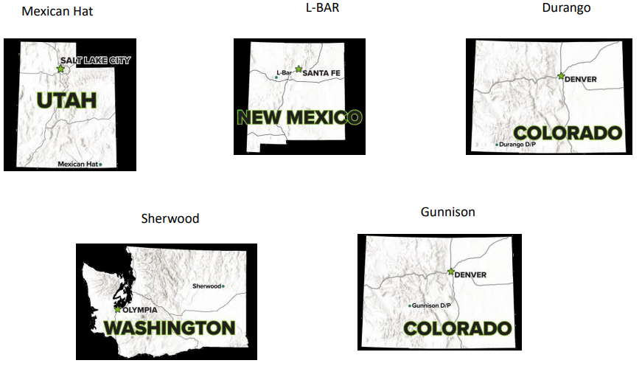
Notes:
These sites were chosen to understand how a different environment can affect the disposal cell

Slide 9
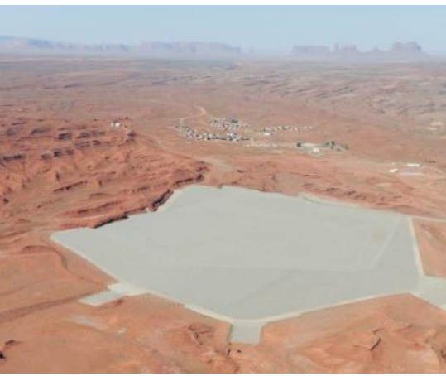
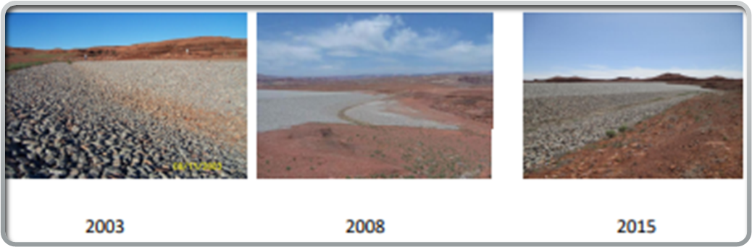
Mexican Hat, Utah
Surface remediation and disposal cell was completed in 1994.
Dry climate like a desert
Rocks and soil keep rolling down the south apron. Up to 12in in diameter
Multiple tumbleweed siting
Erosion
Vegetation increase after rain in 2004. Mostly tamarisk plants
Surface depression
Ponding

Slide 10
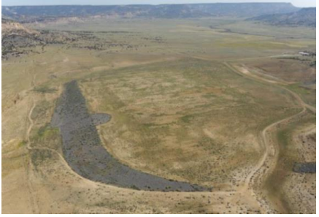
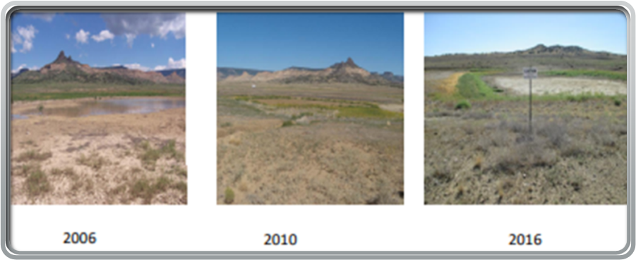
L-Bar, New Mexico
Surface remediation and disposal cell was completed in 2000
Erosion/ Vegetation monitoring
Tamarisk/vegetation growth
Erosion
Ponding
Cracks from saturation
Sediment trap

Slide 11
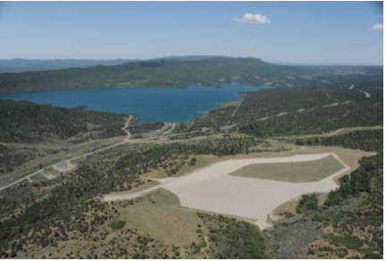
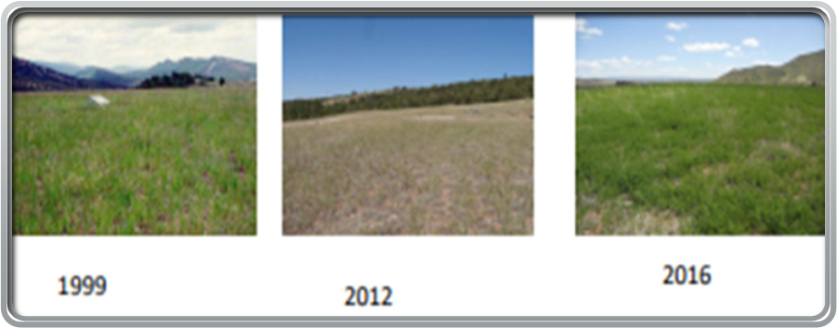
Durango, Colorado
Surface remediation and disposal cell completed in 1990
Animal Burrowing
Vegetation/pine tree on side slopes
Erosion
Retention Pond

Slide 12
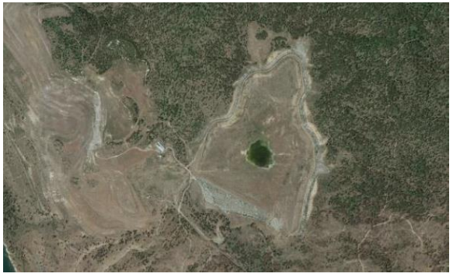
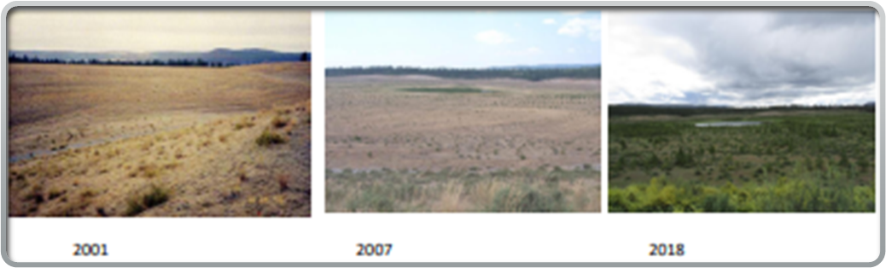
Sherwood, Washington
Surface remediation and disposal cell was completed in 1996
4 ponds
Horses and Buffalos on site
Fire
Trees

Slide 13
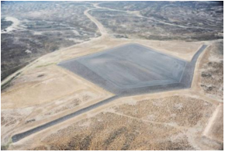
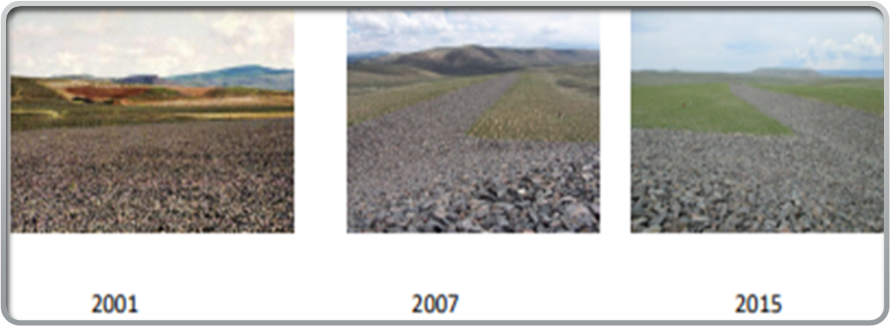
Gunnison, Colorado
Excavation for the disposal cell began in 1992, and construction was completed in 1995.
Ponding and moss rock cover
Heavy Precipitation during the summer
Cottonwood tree sampling
Erosion

Slide 14
Key finding and takeaways
The most important thing I found was how a different environment can affect the disposal cell differently and the function of disposal cells and its impact on the environment and human health.
I was able to apply what I have learned from school into the project. The courses that relate are environmental engineering, geotechnical engineering, and structural engineering.
TAKEAWAYS
✓ Brief history of the sites and why the project is important
✓ I learned how to read annual inspection reports and maps
✓ What to look for when reviewing the documents
✓ How to fill in spreadsheet
✓ Creating timeline

Slide 15
Resources
https://www.energy.gov/sites/default/files/2021-07/MexicanHatFactSheet.pdf
https://www.energy.gov/sites/default/files/2020/06/f75/L-BarFactSheet.pdf
https://www.energy.gov/sites/default/files/2020/06/f75/UMTRCATitleIandIIProgrammaticFactSheet_0.pdf
https://www.energy.gov/lm/mission

Slide 16
Thank You!

